Slide 1
5 The Model View Controller architecture

Slide 2
Main concepts to be covered
Design patterns
The Observer design pattern
The Model View Controller architecture
Notes:
Designmönster beskriver vanliga
Designproblem, och beprövade lösningar
Observer minskar kopplingen i en applikation
MVC mycket användbart i GUI-sammanhang
Bygger på Observer-mönstret

Slide 3
Using design patterns
Inter-class relationships are important, and can be complex.
Some relationship recur in different applications.
Design patterns help clarify relationships, and promote reuse.

Slide 4
Pattern structure
A pattern name.
The problem addressed by it.
How it provides a solution:
  Structures, participants, collaborations.
Its consequences.
  Results, trade-offs.
Notes:
Roller

Slide 5
Design pattern: Observer
Supports separation of internal model from a view of that model.
Observer defines a one-to-many relationship between objects
  publisher - subscriber
The object-observed notifies all Observers of any state change.
Example SimulatorView in the foxes-and-rabbits project.
Notes:
En vy kan vara ett GUI, men även annat
Publisher-subscriber är en bra metafor

Slide 6
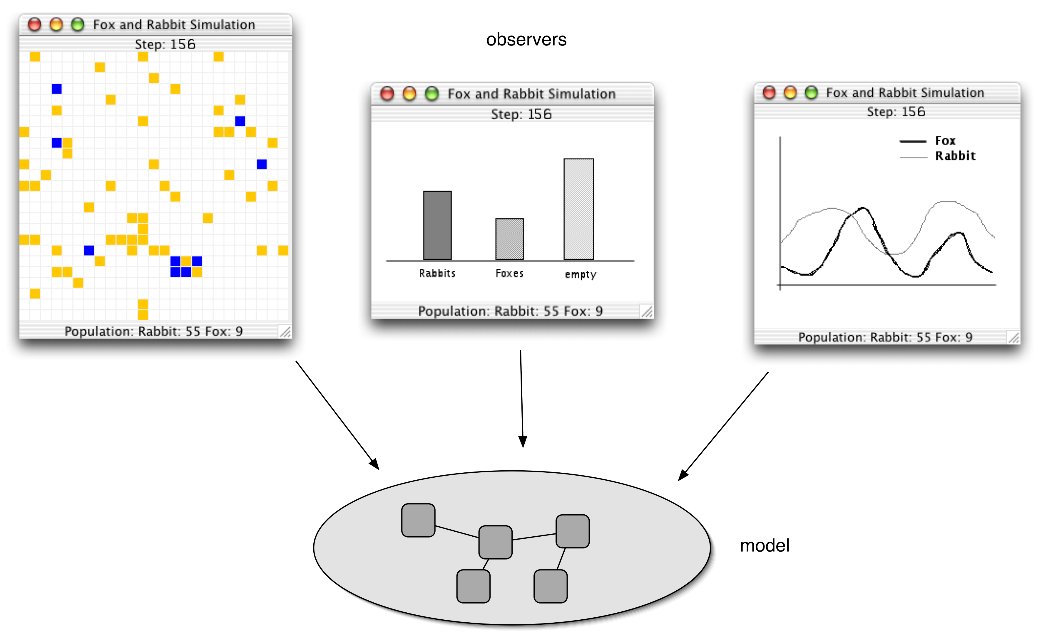
Observers
Notes:
Loggning

Slide 7
Main classes of interest
class Observable
  Subclasses inherit basic functionality for reporting state changes to observing objects.
  Independent of the observer’s logic
interface Observer
  Subclasses implement update funtionality.
  Many objects can connect to the same observable object.
Notes:
Enkla klasser, men kraftfull idé

Slide 8
Class relationships
Observable
Observer
*
No particular owner-owned relationship
  Observers do not own the observed objects.
  Observed objects are unaware of observers.
  The relation is navigable in both directions
    Observers know what they observe.
    Observables must be able to update observers (weak dependency).
Notes:
Tekniskt sett måste observatörerna kunna nås – men på ett uniformt neutralt sätt

Slide 9
Typical configuration
o1 : Observer
obj : Observable
o2 : Observer
o3 : Observer
...

Slide 10
class Observable
public class Observable {
- Add observer o to the set of observers for this object
public void addObserver(Observer o)
- Mark this object as changed
public void setChanged()
- If this object has changed, then notify all of it’s observers
public void notifyObservers()
}
Notes:
Detta är Java-specifikt
Det finns fler metoder – kolla i API:t!

Slide 11
Typical Observable class
public class Obsrvbl extends Observable {
private SomeType x;
public void someMutator() {
...
x = ...; // x has changed, inform observers
setChanged();
notifyObservers(x.clone());
...
}
}
Pass some information to the observers.
Maybe a copy of x, or something else.

Slide 12
interface Observer
public interface Observer {
An observable object calls it’s inherited notifyObservers method
to have all the object's observers notified of a state change. notifyObservers then calls update for each observer.
Parameters:
    o - the observable object who initiated the call.
    arg - the argument that was passed to the
    notifyObservers method by the observable object.
    notifyObservers forwards this argument to update.
void update(Observable o, Object arg);
}

Slide 13
Typical Observer class
public class Obsrvr implements Observer {
...
public void update(Observable o,Object arg) {
if ( o instanceof Obsrvbl &&
arg instanceof SomeType) {
SomeType x = (SomeType)arg;
// take some appropriate action
// based on the value of x
} else
...
}
}
Several objects of different types may be observed by the same observer. Moreover, each observed object may, depending on the situation, pass arguments of different types to update. Hence a case analysis may be necessary.

Slide 14
Typical setup
Observable obj = new Obsrvbl();
Observer o1 = new Obsrvr();
Observer o2 = new Obsrvr();
Observer o3 = new Obsrvr();
obj.addObserver(o1);
obj.addObserver(o2);
obj.addObserver(o3);
Observer registration
Notes:
Prenumeration

Slide 15
Alternative Observer class
public class Obsrvr implements Observer {
public Obsrvr(Observable x) {
...
x.addObserver(this);
...
}
public void update(Observable o,Object arg) {
...
}
}
Observer registration

Slide 16
Alternative setup
Observable obj = new Obsrvbl();
Observer o1 = new Obsrvr(obj);
Observer o2 = new Obsrvr(obj);
Observer o3 = new Obsrvr(obj);
Observer registration
Notes:
Prenumeration

Slide 17
A setup scenario
obj : Obsrvbl
o1 : Obsrvr
o2 : Obsrvr
o3 : Obsrvr
addObserver(this)
addObserver(this)
addObserver(this)
Notes:
Sekvensdiagram – dynamiska aspekter
Scenariomodellering
Här kan det stå this i parameterlistan

Slide 18
An update scenario
obj : Obsrvbl
o1 : Obsrvr
o2 : Obsrvr
o3 : Obsrvr
someStateChange()
setChanged()
notifyObservers(x)
update(obj,x)
update(obj,x)
update(obj,x)
Notes:
Observable har en tabell med observatörer
Lätt att implementera!

Slide 19
The MVC architecture
Reenskaug 1979 (Smalltalk-80)
Model (content)
View (appearance)
Controller (user actions)
Notes:
Det finns många varianter på detta!

Slide 20
Model
Model classes take care of data storing and processing
  business logic
  domain logic
  the “database”
Notes:
Applikationsspecifikt

Slide 21
View
View classes take care of visual aspects
  Visualization
  User interface
  “Model rendering”
  A model can have many views

Slide 22
Controller
Controller classes take care of the control flow between model and view
  User actions
  Event handling
  Communication
Notes:
Detta är lite speciellt i Java

Slide 23
Model (2)
Model objects are
  observable
  unaware of controller and view part
The model is decoupled from the view
Notes:
Här är själva poängen!
Koppling vs. Beroende
Ideala egenskaper
- men kan vara svårt att uppnå i praktiken

Slide 24
View (2)
View objects are
  observers of model objects
  weakly dependent on model and controller
Notes:
Vyn kan vara mer eller mindre domänberoende

Slide 25
Controller (2)
Controller objects
  update the model with information from the view
Example: Action control objects in a GUI

Slide 26
MVC architecture
View
Model
3. update
1. event
2. compute
Controller
Notes:
Den streckade ovalen antyder att
kontrollerna och vyn kan integreras mer eller mindre

Slide 27
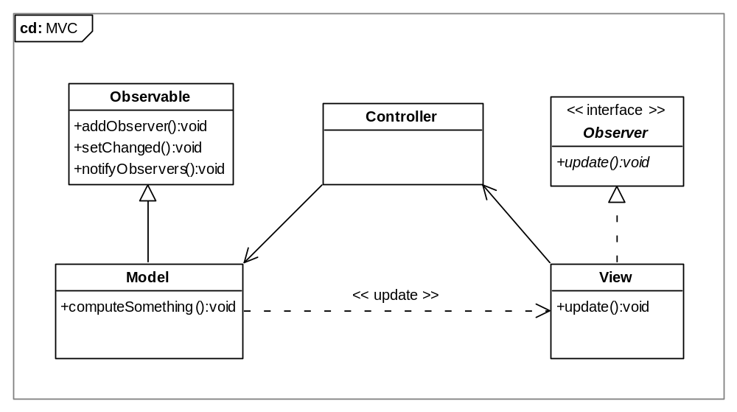
MVC class diagram
Notes:
Streckad pil = svagt beroende
Dema
Koden (följ flödet från knapptryck till uppdatering av vyn)
GUI
Control
Modellklasserna
Interfacet först
Observer bara för tillståndsförändrande operationer

Slide 28
Consequences
Model is completely independent of view.
View is more or less dependent of model and controller
  the view must often have some domain knowledge.
  Eg. Syntax checking in forms.
Controller is dependent of model.

Slide 29
Variations
Variations of the MVC pattern are possible.
More or less coupling between model, view and controller:
  View observes model directly.
  or: Controller mediates all communication between model and view.

Slide 30
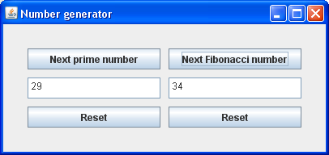
Example: Number series calculator
A (very) simple calculator for exploring the prime number and Fibonacci number series.
Program design based on
the MVC pattern.
Explore the mvc project!

Slide 31
The calculator GUI
:JFrame
:class UserInterface
:JButton
next
next
:JTextField
29
34
:JButton
reset
reset
:JPanel
:class NumberPane
:class NumberPane

Slide 32
Control flow
:NextButton-
Controller
View
button pushed/
actionPerformed()
Model
computeNext()
2
1
next
:Number
generator
3
update(digits)/setText(digits)
reset()
reset
2
1
:ResetButton-
Controller
button pushed/
actionPerformed()

Slide 33
Class design
Observable
<<abstract>>
NumberGenerator
+ computeNext()
+ reset()
+ getValue()
PrimeGenerator
FibonacciGenerator
+ computeNext()
+ reset()
+ getValue()
+ computeNext()
+ reset()
+ getValue()

Slide 34
Class design (cont.)
<<interface>>
Observer
+ update()
JFrame
JPanel
UserInterface
2
NumberPane
2
JButton
+ update()
PrimeGenerator
JTextField
FibonacciGenerator

Slide 35
Class design (cont.)
update
2
JButton
NumberPane
JTextField
ActionListener
NextButtonController
FibonacciGenerator
ResetButtonController

Slide 36
Review
The degree of dependency between components is called coupling.
Aim for less coupling!
The observer design pattern decreases coupling.
The MVC architectural pattern decouples the business logic from GUI issues
  thus easy to modify or replace GUI!

